Slide 1
Generative vs Discriminative Models

Slide 2
Outline
Generative Models
Discriminative Models
Joint Probability and Conditional Probability Distributions

Slide 3
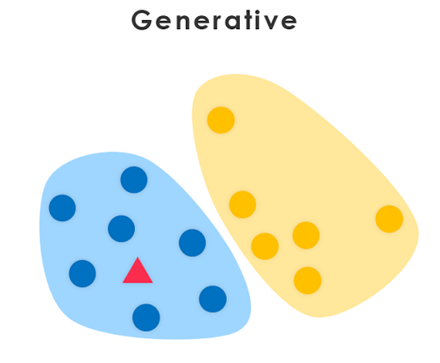
Generative Models
Generative models are machine learning models that learn to generate new data samples similar to the training data they were trained on.
They capture the underlying distribution of the data and can produce novel instances

Slide 4
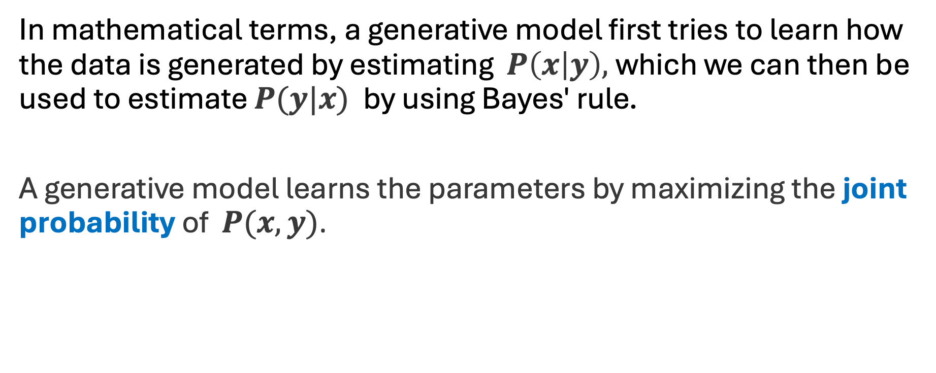
The Math of Generative Models
In mathematical terms, a generative model first tries to learn how the data is generated by estimating $P\left(x | y\right),$which we can then be used to estimate $P(y|x)$ by using Bayes' rule.
A generative model learns the parameters by maximizing the joint probability of $P(x,y)$.

Slide 5
Examples of Generative Models
Naïve Bayes
Hidden Markov Models (covered in Reinforcement Learning)
Generative Adversarial Networks (covered in Deep Learning)

Slide 6

Outline
Generative Models
Discriminative Models
Joint Probability and Conditional Probability Distributions

Slide 7
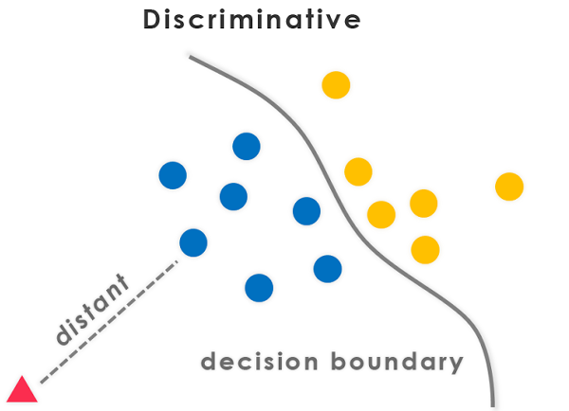
Discriminative Models
Discriminative models focus on modeling the decision boundary between classes in a classification problem.
The goal is to learn a function that maps inputs to binary outputs, indicating the class label of the input.

Slide 8
Discriminative Models
Discriminative models separate classes instead of modeling the conditional probability and don’t make any assumptions about the data points.

Slide 9
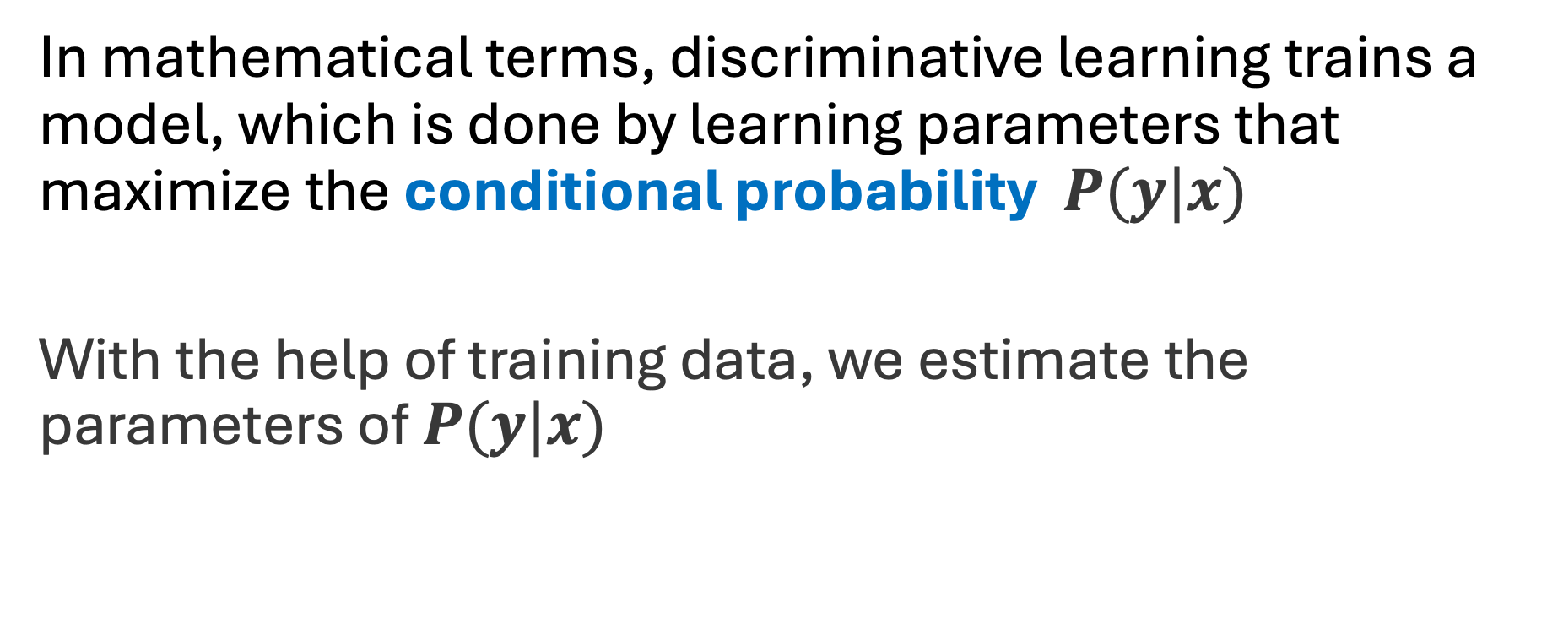
The Math Behind Discriminative Models
In mathematical terms, discriminative learning trains a model, which is done by learning parameters that maximize the conditional probability $P(y|x)$
With the help of training data, we estimate the parameters of $P(y|x)$

Slide 10
Examples of Discriminative Models
Support vector machines(SVMs)
‌Neural networks
‌K-Nearest neighbor
Decision Trees and Random Forest

Slide 11
Outline
Generative Models
Discriminative Models
Joint Probability and Conditional Probability Distributions

Slide 12
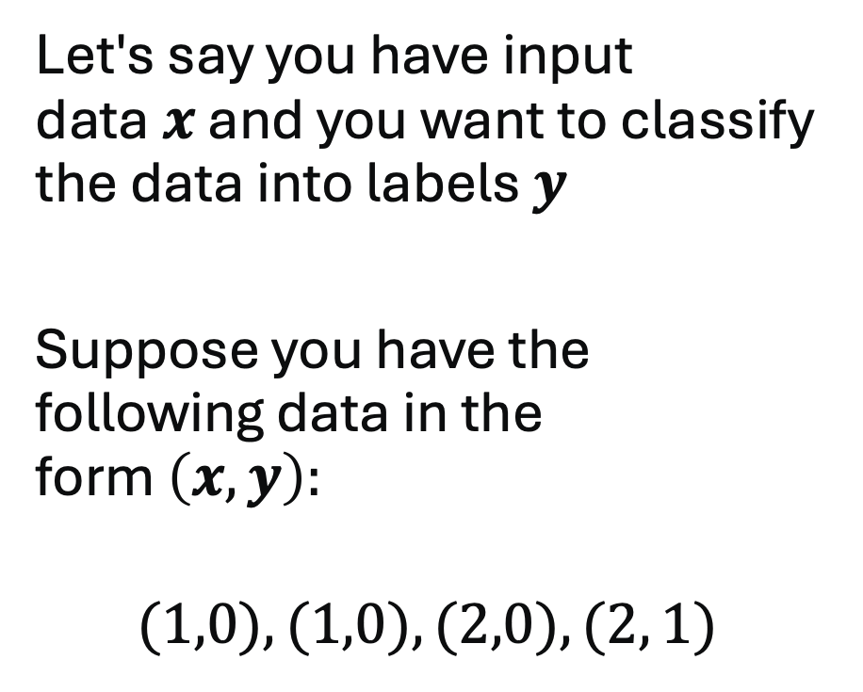
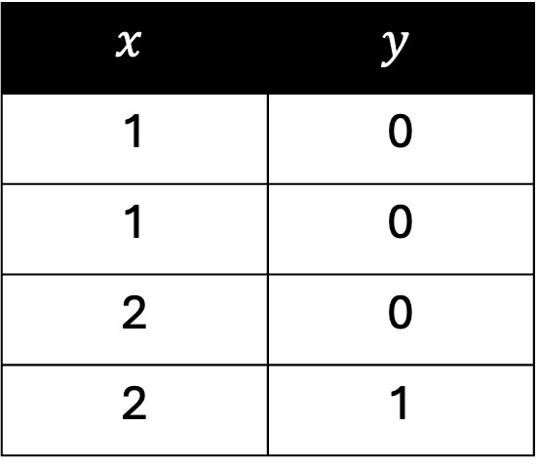
Joint Probability and Conditional Probability
Let's say you have input data $x$ and you want to classify the data into labels $y$
Suppose you have the following data in the form $\left(x,y\right):$
$$(1,0), (1,0), (2,0), (2, 1)$$
$$x$$ | $$y$$
1 | 0
1 | 0
2 | 0
2 | 1

Slide 13


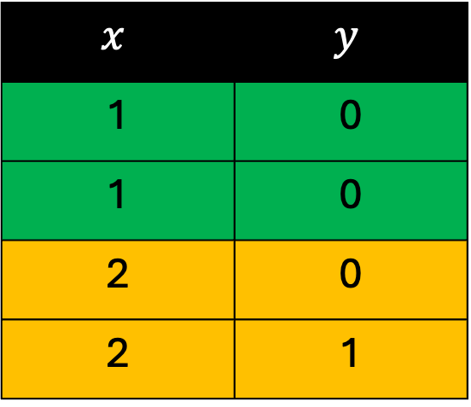
Joint Probability $P(x,y)$
A generative model learns the joint probability distribution $p(x,y)$
There is a 50% probability that $x$ will be labeled as 0 if $x=1$
$$x$$ | $$y$$
1 | 0
1 | 0
2 | 0
2 | 1

Slide 14
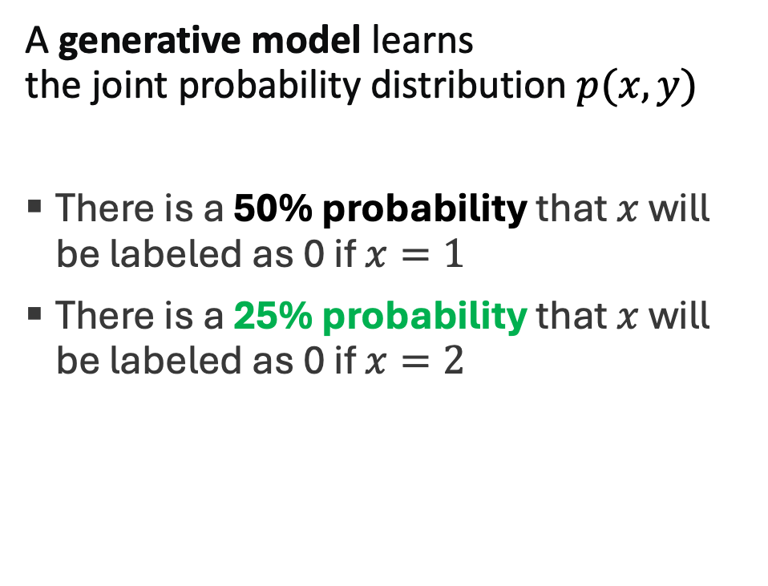
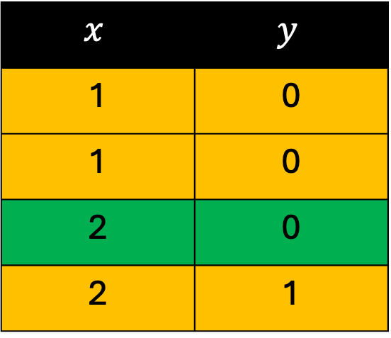
Joint Probability $P(x,y)$
A generative model learns the joint probability distribution $p(x,y)$
There is a 50% probability that $x$ will be labeled as 0 if $x=1$
There is a 25% probability that $x$ will be labeled as 0 if $x=2$
$$x$$ | $$y$$
1 | 0
1 | 0
2 | 0
2 | 1

Slide 15
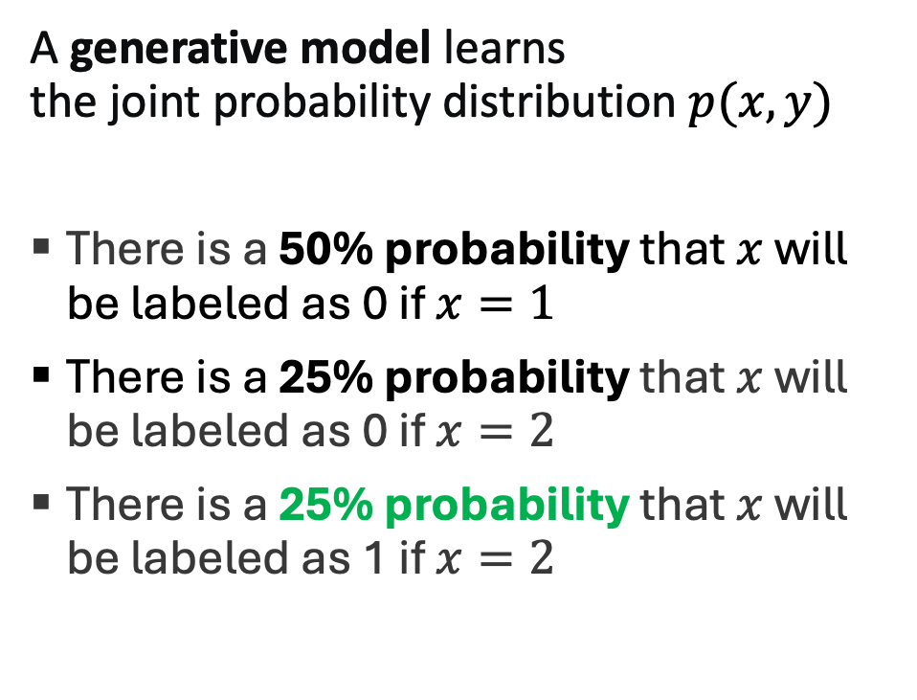
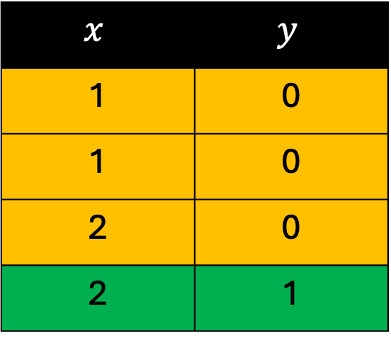
Joint Probability $P(x,y)$
A generative model learns the joint probability distribution $p(x,y)$
There is a 50% probability that $x$ will be labeled as 0 if $x=1$
There is a 25% probability that $x$ will be labeled as 0 if $x=2$
There is a 25% probability that $x$ will be labeled as 1 if $x=2$
$$x$$ | $$y$$
1 | 0
1 | 0
2 | 0
2 | 1

Slide 16


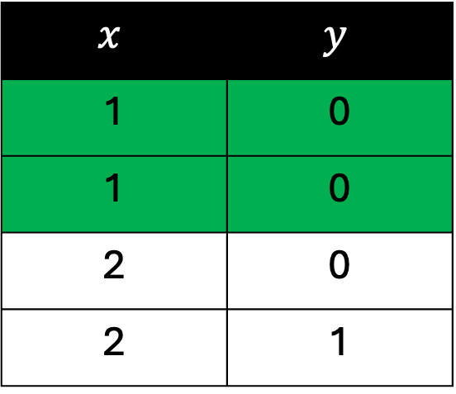
Conditional Probability $P(y|x)$
A discriminative model learns the conditional probability distribution $p\left(y | x\right)$
There is a 100% probability that $x$ will be labeled as 0 if $x=1$
$$x$$ | $$y$$
1 | 0
1 | 0
2 | 0
2 | 1

Slide 17
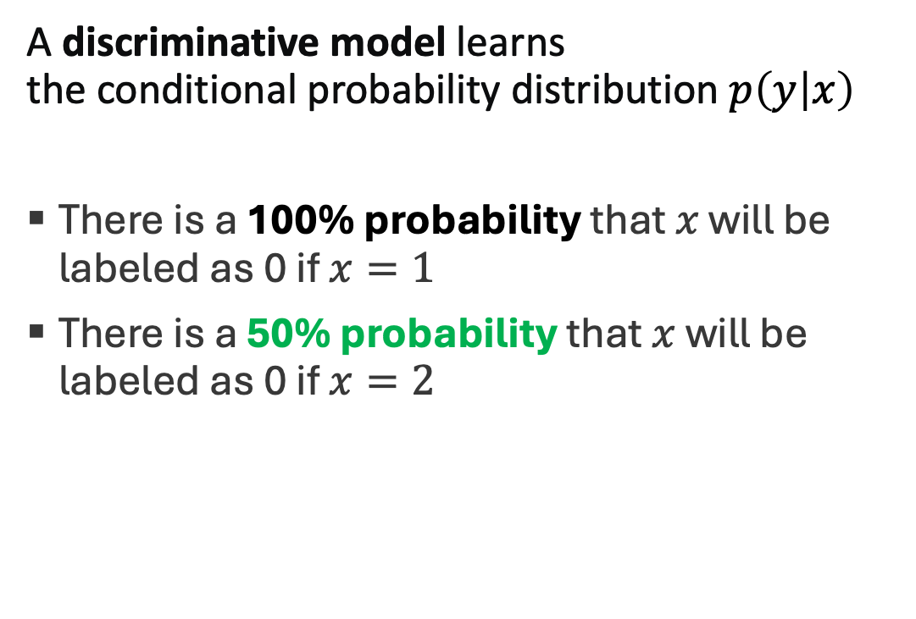
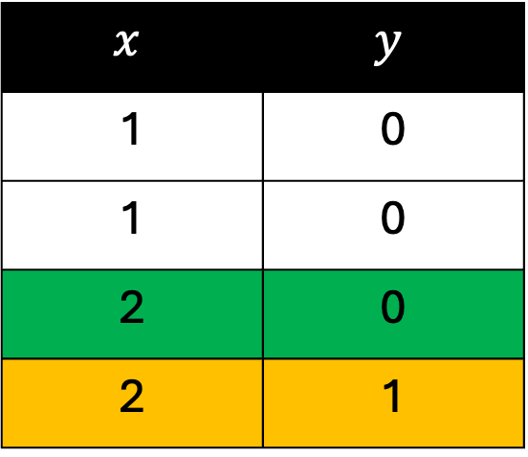
Conditional Probability $P(y|x)$
A discriminative model learns the conditional probability distribution $p\left(y | x\right)$
There is a 100% probability that $x$ will be labeled as 0 if $x=1$
There is a 50% probability that $x$ will be labeled as 0 if $x=2$
$$x$$ | $$y$$
1 | 0
1 | 0
2 | 0
2 | 1

Slide 18
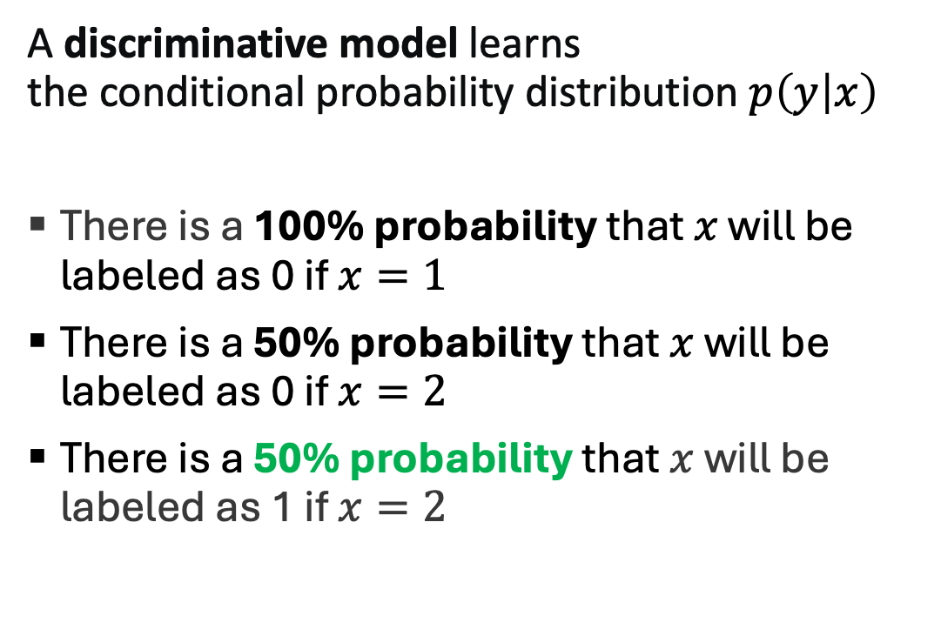
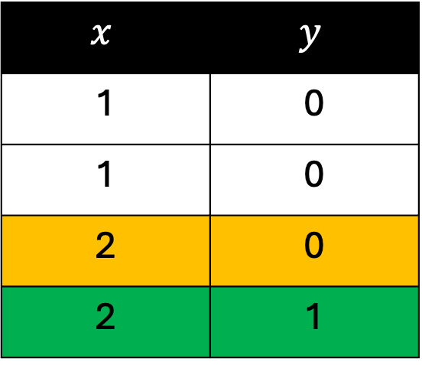
Conditional Probability $P(y|x)$
A discriminative model learns the conditional probability distribution $p\left(y | x\right)$
There is a 100% probability that $x$ will be labeled as 0 if $x=1$
There is a 50% probability that $x$ will be labeled as 0 if $x=2$
There is a 50% probability that $x$ will be labeled as 1 if $x=2$
$$x$$ | $$y$$
1 | 0
1 | 0
2 | 0
2 | 1

Slide 19
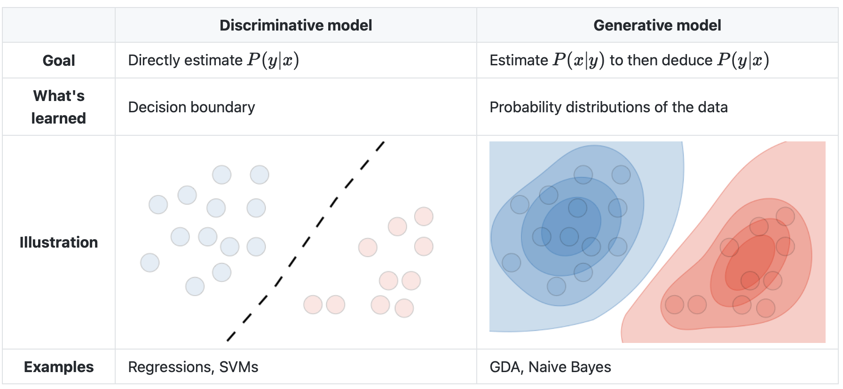

Slide 20
References
https://developers.google.com/machine-learning/gan/generative
https://stanford.edu/~shervine/teaching/cs-229/cheatsheet-supervised-learning

